Slide 1
Indexing
— Chapter 14
2021年11月
叶文
yewen@bupt.edu.cn
School of Computer Science (National Pilot Software Engineering School)

Slide 2
Outline
Basic Concepts
Ordered Indices
B⁺-Tree Index Files
B-Tree Index Files
Hashing
【略 Bitmap Indices】
【略：Spatio-Temporal Indexing】

Slide 3
目标
学会正确建立、管理索引，提高数据库访问速度
参见P69-77：适宜建立索引的属性
索引对select/update/insert/delete的影响
例题
索引类型
数据库访问，e.g., select, insert, delete, update, 时的索引管理，了解索引对select/update/insert/delete的影响
复合索引左前缀原则
实验7. 数据库物理设计
实验8. 查询优化

Slide 4
14.1 Basic Concepts
How to locate tuples/records in DB file quickly?
Indexing (索引技术) mechanisms
used to speed up access to desired data
e.g. for relation instructor(ID, name, dept_name, salary)
shown in Fig.14.1, the index
dept_name → physical address of record (i.e.tuple) in DB file instructor
Search Key
attributes or a set of attributes used to look up the records in a file
e.g. dept_name

Slide 5
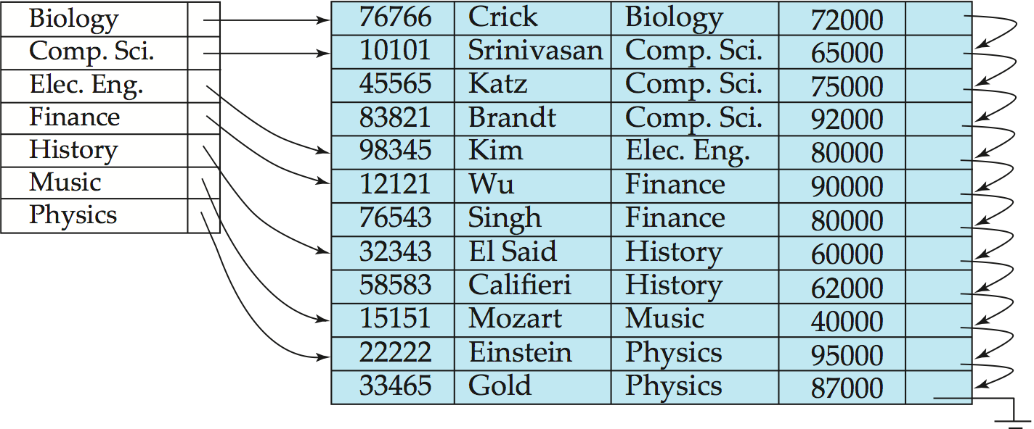
instructor(ID, name, dept_name, salary)
logical file
instructor
index file
Fig. 14.1 DB indexed file instructor and its index file
indexed file
Note: the file instructor is logically a sequential file, but its records may be stored non-contiguously or non-ordered on the disk
76766
98345
58583
physical
file instructor
10101
12121
15151
45565
76543
22222
83821
32343
33465

Slide 6
Basic Concepts (cont.)
An index file consists of records (called index entries) of the form
Index files are typically much smaller than the original file
Indexing
mapping from search-key to storage locations of the file records,
i.e. search-key → storage locations of the records in disks
search-key
pointer

Slide 7
ordered indices
hash indices
{索引项}
index entry
r(R), R (A, B, S, …. , , D)
a₁
b₁
s₁
…
d₁
s₁
s₂
s₃
.
.
s_{i}
.
.
s_{j}
.
s_{n}
a₂
b₂
s₂
…
d₂
h(s₁)
s₁
s₂
s₃
.
.
s_{i}
.
.
s_{j}
.
s_{n}
a₃
b₃
s₃
…
d₃
h(s_{i})→#buket
s₁
s₂
s₃
…
s_{i}
…
s_{m}
…
…
…
…
…
…
a_{i}
b_{i}
s_{i}
…
d_{i}
…
…
…
…
…
h(s_{i})
散列
函数H
a_{j}
b_{j}
s_{j}
…
d_{j}
…
…
…
…
…
…
…
a_{m}
b_{m}
s_{m}
…
d_{m}
…
…
…
…
…
…
a_{n-1}
b_{n-1}
s_{n-1}
…
d_{n-1}
h(s_{n})
a_{n}
b_{n}
s_{n}
…
d_{n}
搜索键
(search key)
索引文件
(index file)
搜索键
(search key)
数据文件
（主文件、被索引文件indexed file）
图 14.0.1 索引技术(indexing)及其分类

Slide 8
Basic Concepts (cont.)
Two basic kinds of indices:
ordered indices: the index file is used to store the index entries in which the search key of the records and the address of the records are stored in sorted order
hash indices: the “hash function” is used to map the the search key of the records to the address of the records
the records are stored in the “buckets”（概念上的？！）, the number of the bucket is as the address of the records and is determined by the hash function
Access types supported efficiently
等值查询，records with a specified value in the attribute,
e.g. ID=1254
比较查询，e.g. salary>10000
范围查询，records with an attribute value falling in a specified range of values,
e.g. salary between 10000 and 20000

Slide 9
Index Evaluation Metrics
Access time
Insertion time
Deletion time
Space overhead

Slide 10
14.2 Ordered Indices
DBS files with indexing mechanism include two parts :
indexed file, in which data records are stored
index file, in which index entries are included
e.g. Fig.14.1
The indexed file can be organized as
sequential file, heap file, hash file, clustering file
Ordered index (in index file)
the index entries in the index file are stored in some sorted order, for instance, in accordance with the order of the search key
/* 索引项的排列顺序与(被索引文件中)搜索键的排列顺序一致
e.g. in Fig.14.1( ) , the index file is sorted by dept_name

Slide 11
Primary and Secondary Indices
Primary/clustering index (in the index file)
considering a index file and its corresponding indexed file
the indexed file is a sequential file, and the index whose search key also specifies the sequential order of the indexed file
/* 索引文件的搜索键所规定的顺序与被索引的顺序文件中的纪录顺序一致
e.g. in Fig.14.1 , (dept_name, address of records) defines the same orders of the records as that in sequential indexed file instructor
note: also called clustering index
The search key of a primary index is usually but not necessarily the primary key
e.g. in Fig. 14.1, dept-name is not the primary key of instructor

Slide 12
聚集索引 vs 主索引
在实际数据库系统中，如SQL Server、DB2等，
聚集索引
索引文件的搜索键所规定的顺序与被索引的顺序文件中的纪录顺序一致
主索引
建立在主键（主属性上）的索引
当一个表定义了主键后，DBMS自动为该表在主键上建立聚集索引，该索引同时又是主索引
主索引一定是聚集索引，但聚集索引不一定是主索引
一个表上只能建立一个聚集索引，也只能有一个主索引
why？ 数据文件根据索引项进行排序，只能有一种排列顺序
表可以建立多个非聚集索引
如果一个表上没有定义主键，则不会有主索引；但可以为该表建立一个聚集索引

Slide 13
Primary and Secondary Indices
实验：对比分析
在没有定义主键的关系表中插入数据：
在关系表所在数据库文件中，各个元组/行/记录顺序一般是无序，取决于数据插入顺序——heap文件
e.g. select * from tablename
在有主键的关系表中插入数据：
数据库文件是有序的，按照主键顺序排列

Slide 14
Primary and Secondary Indices
Secondary index
an index whose search key specifies an order different from the sequential order of the file
also called non-clustering index
e.g. Fig.14.6 , secondary index on salary field of instrutor
secondary indices have to be dense indices
Index-sequential file (索引顺序文件)
ordered sequential file with a primary/clustering index on the search key
e.g. Fig.14.1

Slide 15
buckets
instructor(ID, name, dept_name, salary)
99540 Wan Comp.Sci 87000
Fig. 11.6 Secondary index on salary field of instructor
Index record points to a bucket that contains pointers to all the actual records with that particular search-key value.
Secondary indices have to be dense

Slide 16
Dense and Sparse Indices
Dense index
the index record in the index file appears for every search-key value in the indexed file
each value of search-key in the indexed file corresponds to an index entry in the index file
e.g. Fig.14.1
dense index on dept_name, with instructor file sorted on dept_name
Sparse Index
index file contains index entries for only some search-key values in the indexed file
e.g. Fig.14.3

Slide 17
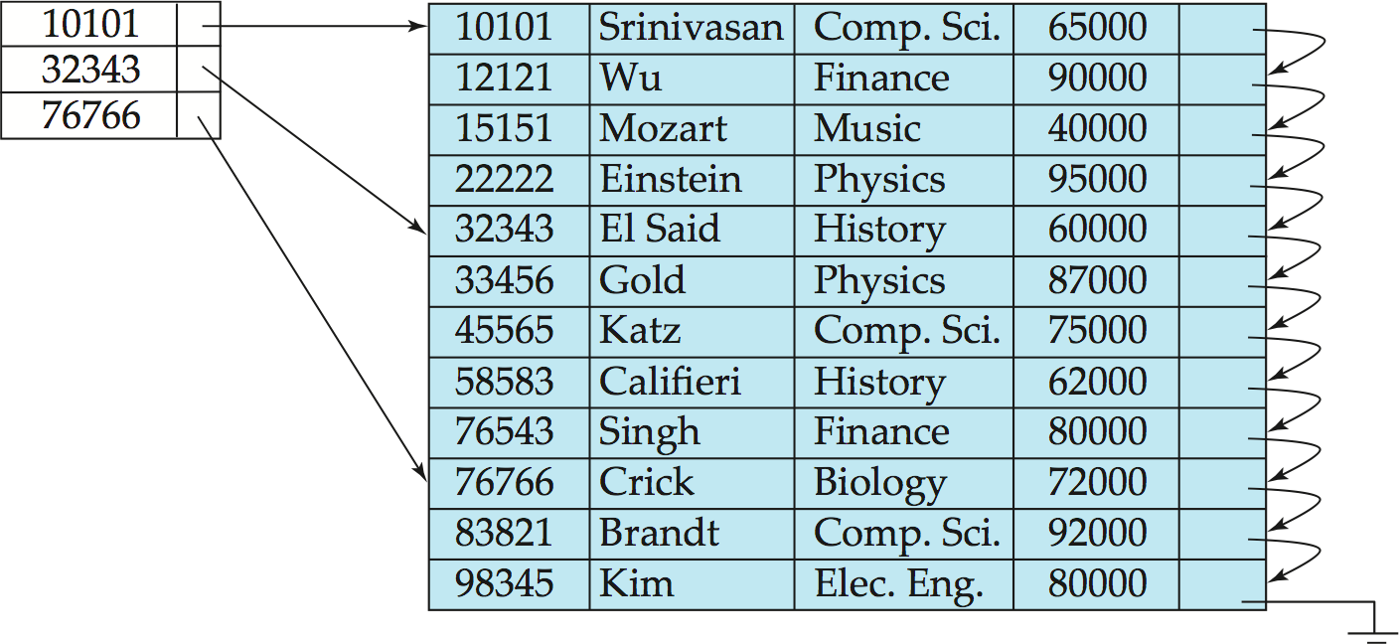
index file
indexed file
Fig.11.3 Sparse index for the file instructor

Slide 18
Dense and Sparse Indices
In a dense primary index, the index record contains the search-key value and a pointer to the first record with that search-key value
the rest of the records with the same search-key value would be stored sequentially after the first record
e.g. Fig.14.1, search-key value “Comp.Sci” corresponds to three records in the file
For a sparse index, to locate a file record with search-key value K
find index entry with largest search-key value ≤ K
search file sequentially starting at the record to which this index entry points

Slide 19
Primary vs Secondary Indices
Indices offer substantial benefits when searching for records.
However,
Updating indices imposes overhead on database modification --when a file is modified, every index on the file must be updated,
Sequential scan using primary index is efficient, but a sequential scan using a secondary index is expensive
Each record access may fetch a new block from disk
Block fetch requires about 5 to 10 milliseconds, versus about 100 nanoseconds for memory access

Slide 20
Multi-level Indices
The index file may be very large, and cannot be entirely kept in memory
If primary index does not fit in memory, access becomes expensive.
Solution: treat primary index kept on disk as a sequential file and construct a sparse index on it.
outer index – a sparse index of primary index file
inner index – the primary index file
If even outer index is too large to fit in main memory, yet another level of index can be created, and so on.

Slide 21
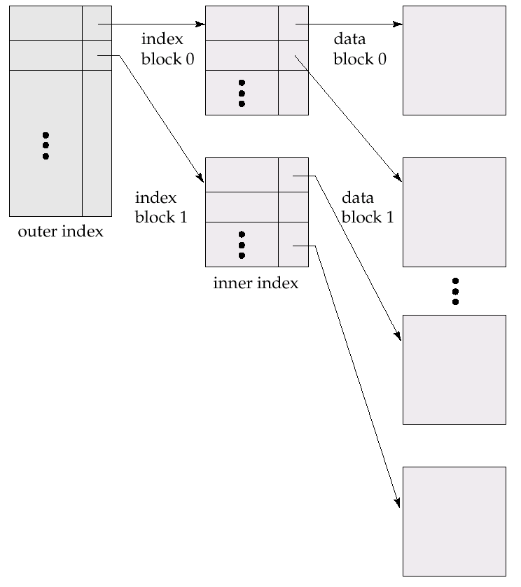
B⁺-tree indices and B-tree indices are two types of efficient multi-level indices, and widely used in DBS and OS file systems
index file
Fig. 11.5
Two-level sparse index
Note: similar to hierarchical the page tables or the file index and in OS
indexed file

Slide 22
Indices on Multiple Keys
Composite search keys are search keys containing more than one attribute
E.g. (dept_name, salary)
E.g.
create index Mutiple-index on takes(course_id, semester, year )
Lexicographic ordering: (a₁, a₂) < (b₁, b₂) if either
a₁ < b₁, or
a₁=b₁ and a₂ < b₂

Slide 23
复合索引左前缀原则
Suppose we have an index on combined search-key
(dept_name, salary)
With the where clause where dept_name = “Finance” and salary = 80000
the index on (dept_name, salary) can be used to fetch only records that satisfy both conditions.
Can also efficiently handle where dept_name = “Finance” and salary < 80000
Can also efficiently handle
where dept_name = “Finance”

Slide 24
复合索引左前缀原则
But cannot efficiently handle
1. where dept_name < “Finance” and salary = 80000
may fetch many records that satisfy the first but not the second condition
the index is not used efficiently
2. where salary = 80000
the index is not used for query

Slide 25
14.3/14.4 B⁺-Tree/B-Tree Index Files
Wikipedia
1. B tree is a self-balancing tree data structure that keeps data stored and allows searches, sequential accesses, insertions, and deletions in logarithmic time
2. The B tree is a generalization of a binary search tree in that a node can have more than two children.
3. It is commonly used in databases and file systems
B⁺-tree indices are an alternative to indexed-sequential file
Extensively used multi-level index, with advantages
automatically reorganizes itself with small, local, changes, in the face of insertions and deletions
reorganization of entire file is not required to maintain performance
B-tree
first proposed in 1970, Bayer R, Mccreight E. Organization and maintenance of large ordered indices[C]// ACM Sigfidet. ACM, 1970:107-141
B tree基础上演化产生了B+tree
B?: Balanced, Boeing, Bayer

Slide 26
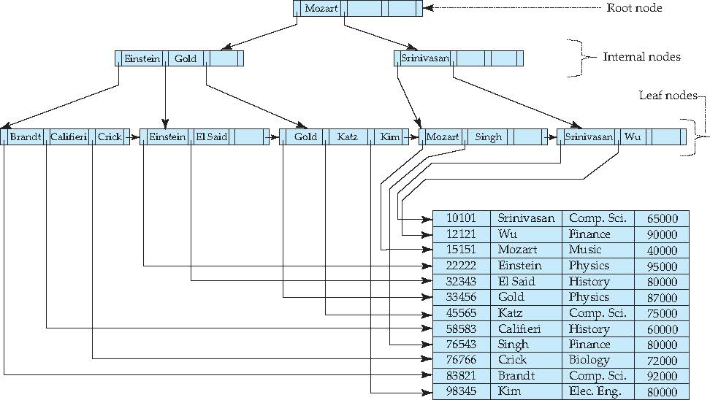
B⁺-Tree (n=4) Index Sequential File Primary/Clustered index on ID
n: degree or branching factor
文件记录直接存储在叶节点
B+树结果不唯一，取决于数据插入顺序
76543
22222
33456
83821
10101
12121
15151
22222
32343
33456
45565
58583
76543
76766
83821
98345
create table instructor
(ID integer, primary key;
…..
)
Or:
create clustered index IDIndex
on instructor(ID)

Slide 27
B⁺-Tree (n=4) secondary/nonclustered index on name
n: degree or branching factor
B+树结果不唯一，取决于数据插入顺序
叶节点存储指向文件记录的指针
k₁
k₂
P₁
P₂
P₃
12 records
instructor(ID, name, dept_name, salary)

Slide 28
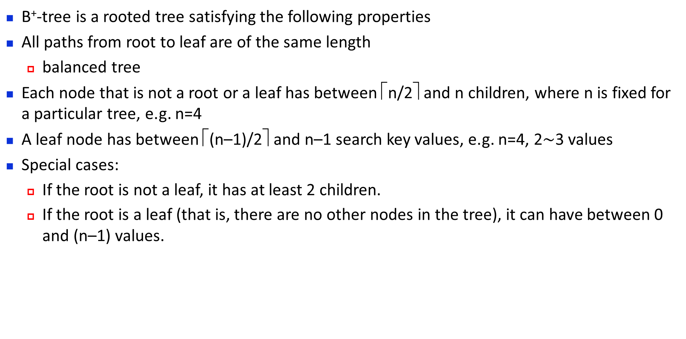
B⁺-tree Properties
B⁺-tree is a rooted tree satisfying the following properties
All paths from root to leaf are of the same length
balanced tree
Each node that is not a root or a leaf has between ⎡n/2⎤ and n children, where n is fixed for a particular tree, e.g. n=4
A leaf node has between ⎡(n–1)/2⎤ and n–1 search key values, e.g. n=4, 2$\sim$3 values
Special cases:
If the root is not a leaf, it has at least 2 children.
If the root is a leaf (that is, there are no other nodes in the tree), it can have between 0 and (n–1) values.

Slide 29
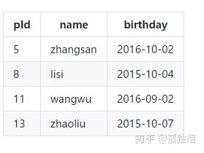
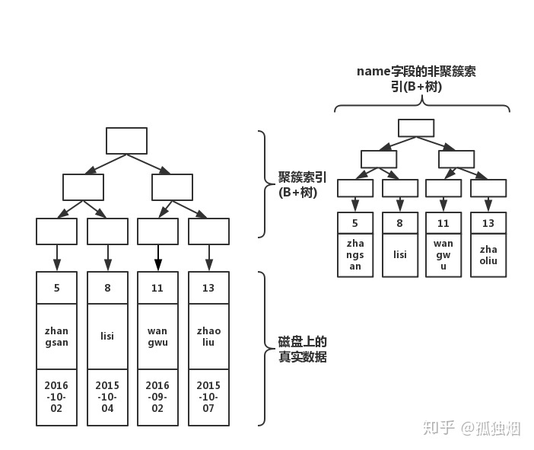
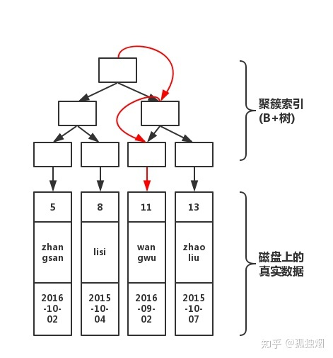
Examples
建立在name上的非聚集索引
建立在主键pid上的聚集索引
根据主键pid=11查找记录
叶结点存<name,pid>

Slide 30
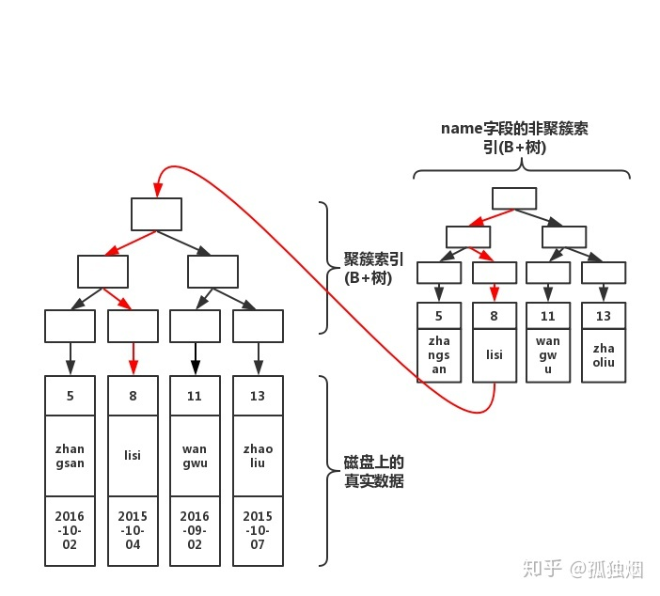
Examples
根据name查找记录:
在非聚集索引中，根据name=lisi找到对应的主键pid=8
在聚集索引中，根据pid=8找到对应的记录

Slide 31
B⁺-Tree Node Structure
The search-keys in a node are ordered
Typical node
K_{i} are the search-key values
P_{i} are pointers to children (for non-leaf nodes) or pointers to records or buckets of records (for leaf nodes).
K₁ < K₂ < K₃ < . . . < K_{n–1}
(Initially assume no duplicate keys, address duplicates later)

Slide 32
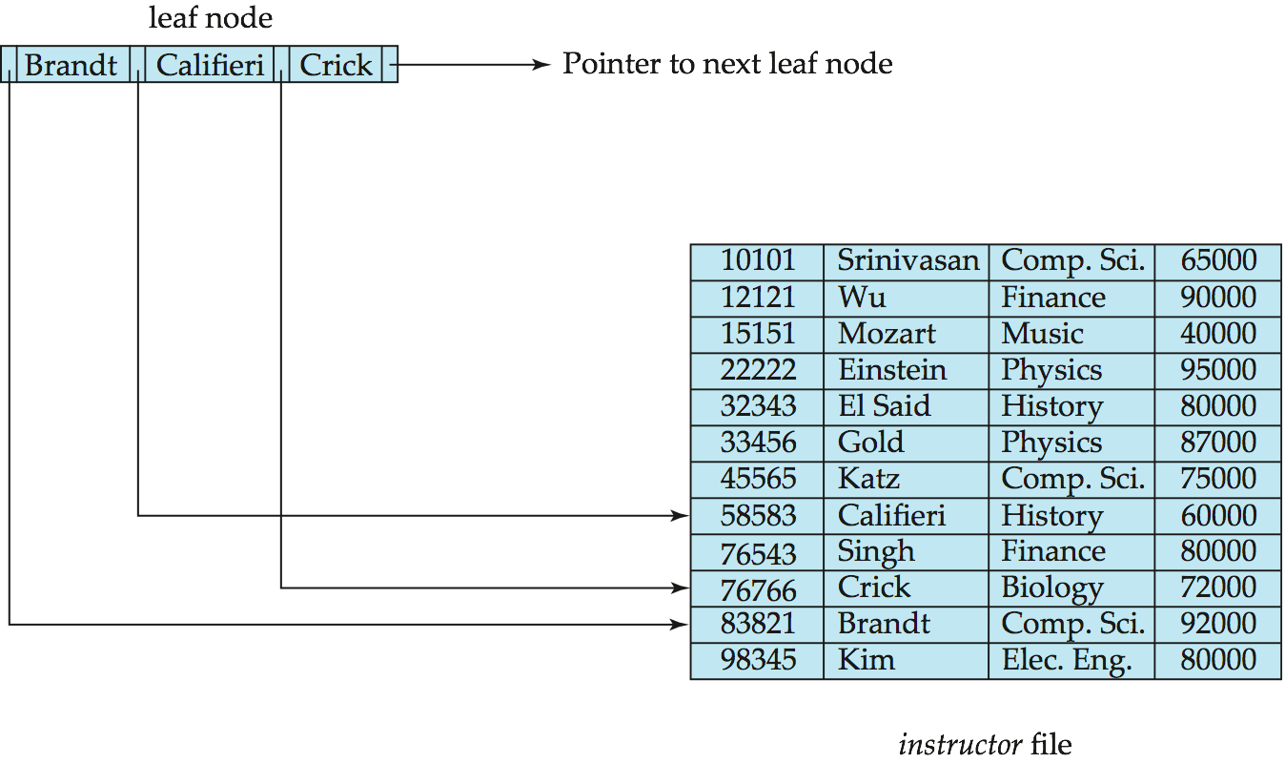
Leaf Nodes in B⁺-Trees
Properties of a leaf node:
For i = 1, 2, . . ., n–1, pointer P_{i} points to a file record with search-key value K_{i},
If L_{i}, L_{j} are leaf nodes and i < j, L_{i}’s search-key values are less than or equal to L_{j}’s search-key values
P_{n} points to next leaf node in search-key order

Slide 33
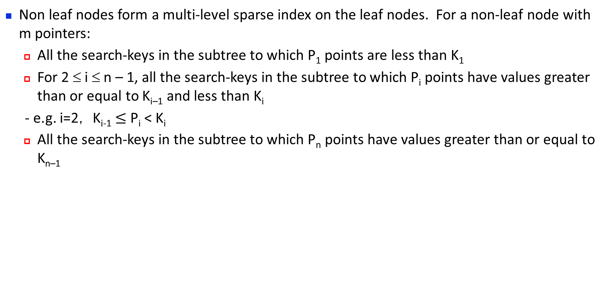
Non-Leaf Nodes in B⁺-Trees
Non leaf nodes form a multi-level sparse index on the leaf nodes. For a non-leaf node with m pointers:
All the search-keys in the subtree to which P₁ points are less than K₁
For 2 ≤ i ≤ n – 1, all the search-keys in the subtree to which P_{i} points have values greater than or equal to K_{i–1} and less than K_{i}
- e.g. i=2， K_{i-1} $≤$ P_{i} < K_{i}
All the search-keys in the subtree to which P_{n} points have values greater than or equal to K_{n–1}

Slide 34
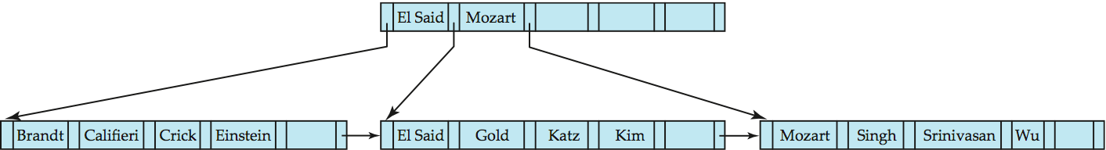
Example of B⁺-tree
Leaf nodes must have between 3 and 5 values (⎡(n–1)/2⎤ and n –1, with n = 6).
Non-leaf nodes other than root must have between 3 and 6 children (⎡(n/2⎤ and n with n =6).
Root must have at least 2 children
k₁
k₂
P₁
P₃
P₂
B⁺-tree for instructor file (n = 6)

Slide 35
Observations about B+-trees：B⁺-trees Performance
Since the inter-node connections are done by pointers, “logically” close blocks need not be “physically” close.
The non-leaf levels of the B⁺-tree form a hierarchy of sparse indices.
The B⁺-tree contains a relatively small number of levels
Level below root has at least 2* ⎡n/2⎤ values
Next level has at least 2* ⎡n/2⎤ * ⎡n/2⎤ values
.. etc.
If there are K search-key values in the file, the tree height is no more than ⎡ log_{⎡n/2⎤}(K)⎤
thus searches can be conducted efficiently.
Insertions and deletions to the main file can be handled efficiently, as the index can be restructured in logarithmic

Slide 36
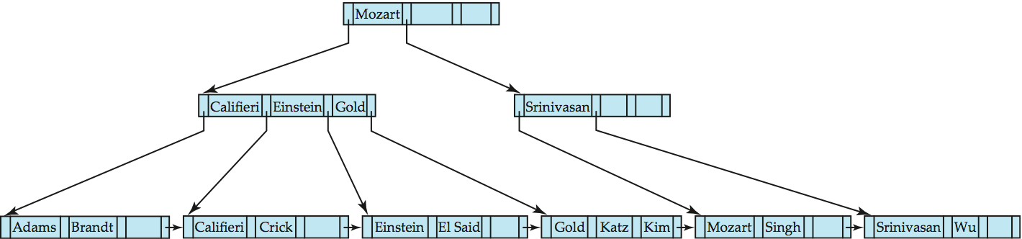
Queries on B⁺-Trees
Find record with search-key value V.
C=root
While C is not a leaf node {
Let i be least value s.t. V ≤ K_{i}.
If no such exists, set C = last non-null pointer in C
Else { if (V= K_{i} ) Set C = P_{i +1} else set C = P_{i}}
}
Let i be least value s.t. K_{i} = V
If there is such a value i, follow pointer P_{i} to the desired record.
Else no record with search-key value k exists
<
≥

Slide 37
Queries on B⁺-Trees
Range queries find all records with search key values in a given range
See book for details of function findRange(lb, ub) which returns set of all such records
Real implementations usually provide an iterator interface to fetch matching records one at a time, using a next() function

Slide 38
Queries on B⁺⁻Trees (Cont.)
If there are K search-key values in the file, the height of the tree is no more than
⎡log_{⎡n/2⎤}(K)⎤
Example
a node is generally the same size as a disk block, typically 4 kilobytes
and n is typically around 100, 40 bytes per index entry
with 1 million search key values and n = 100, at most log₅₀(1,000,000) = 4 nodes are accessed in a lookup
Contrast this with a balanced binary tree with 1 million search key values — around 20 nodes are accessed in a lookup
above difference is significant since every node access may need a disk I/O, costing around 20 milliseconds

Slide 39
Non-Unique Keys
If a search key a_{i} is not unique, create instead an index on a composite key (a_{i} , A_{p}), which is unique
A_{p} could be a primary key, record ID, or any other attribute that guarantees uniqueness
Search for a_{i} = v can be implemented by a range search on composite key, with range (v, - ∞) to (v, + ∞)
But more I/O operations are needed to fetch the actual records
If the index is clustering, all accesses are sequential
If the index is non-clustering, each record access may need an I/O operation

Slide 40
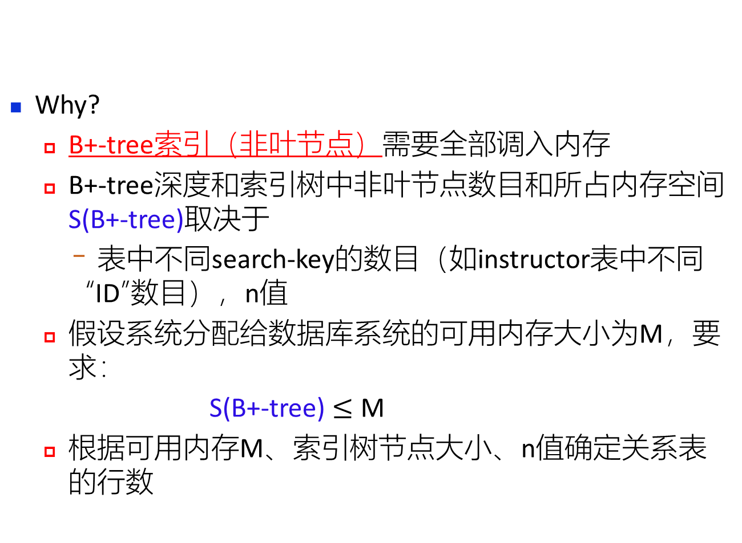
Queries on B⁺⁻Trees (Cont.)
Why?
B+-tree索引（非叶节点）需要全部调入内存
B+-tree深度和索引树中非叶节点数目和所占内存空间S(B+-tree)取决于
表中不同search-key的数目（如instructor表中不同“ID”数目），n值
假设系统分配给数据库系统的可用内存大小为M，要求：
S(B+-tree) $≤$ M
根据可用内存M、索引树节点大小、n值确定关系表的行数
MySQL数据库中，索引树n<=100。
一张表可支持10亿行数据，但为了控制B+-tree索引深度，一般不超过2000万行

Slide 41
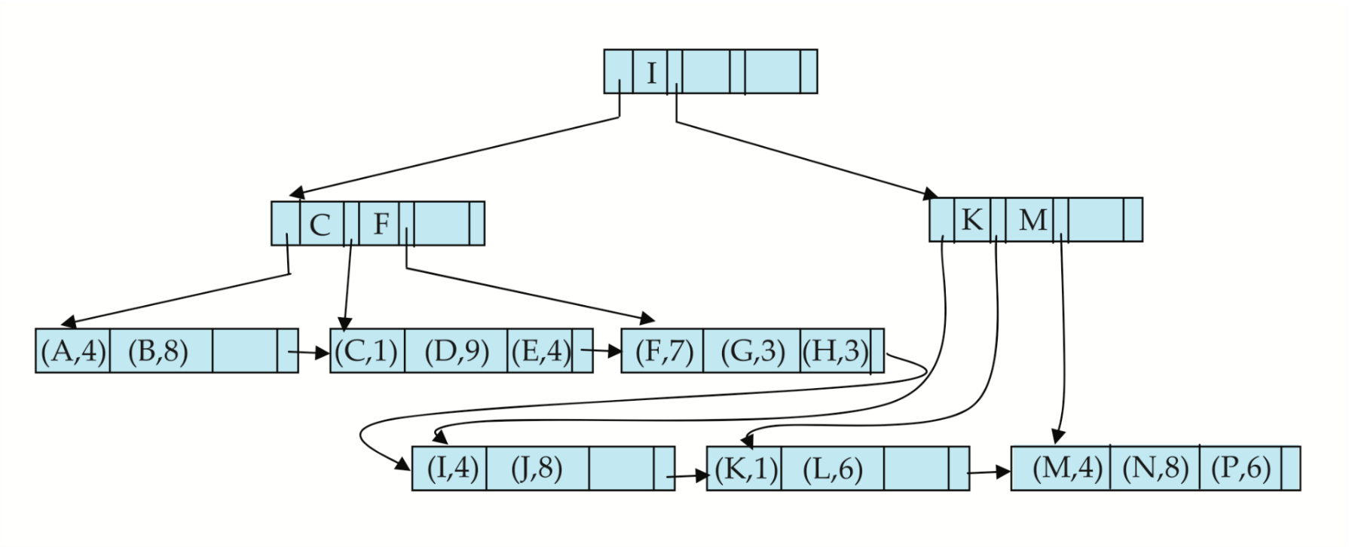
B⁺-Tree File Organization
Index file degradation problem is solved by using B⁺-Tree indices
multi-level indices
Data file degradation problem is solved by using B⁺-Tree File Organization
the leaf nodes in a B⁺-tree file organization store records, instead of pointers, e.g. in MySQL
Example of B⁺-tree File Organization
Leaf nodes are still required to be half full
Since records are larger than pointers, the maximum number of records that can be stored in a leaf node is less than the number of pointers in a nonleaf node.

Slide 42
B⁺-Tree File Organization
Insertion and deletion are handled in the same way as insertion and deletion of entries in a B⁺-tree index.
Good space utilization important since records use more space than pointers.
To improve space utilization, involve more sibling nodes in redistribution during splits and merges
Involving 2 siblings in redistribution (to avoid split / merge where possible) results in each node having at least entries

Slide 43
Other Issues in Indexing
Record relocation and secondary indices
If a record moves, all secondary indices that store record pointers have to be updated
Node splits in B⁺-tree file organizations become very expensive
Solution: use search key of B⁺-tree file organization instead of record pointer in secondary index
Add record-id if B⁺-tree file organization search key is non-unique
Extra traversal of file organization to locate record
Higher cost for queries, but node splits are cheap

Slide 44
Indexing Strings
Variable length strings as keys
Variable fanout
Use space utilization as criterion for splitting, not number of pointers
Prefix compression
Key values at internal nodes can be prefixes of full key
Keep enough characters to distinguish entries in the subtrees separated by the key value
E.g., “Silas” and “Silberschatz” can be separated by “Silb”
Keys in leaf node can be compressed by sharing common prefixes

Slide 45
Bulk Loading and Bottom-Up Build
Inserting entries one-at-a-time into a B⁺-tree requires ≥ 1 IO per entry
assuming leaf level does not fit in memory
can be very inefficient for loading a large number of entries at a time (bulk loading)
Efficient alternative 1:
sort entries first (using efficient external-memory sort algorithms discussed later in Section 12.4)
insert in sorted order
insertion will go to existing page (or cause a split)
much improved IO performance, but most leaf nodes half full
Efficient alternative 2: Bottom-up B⁺-tree construction
As before sort entries
And then create tree layer-by-layer, starting with leaf level
details as an exercise
Implemented as part of bulk-load utility by most database systems

Slide 46
Updates on B⁺-Trees 【略】
Delete
Update
Insert

Slide 47
Non-Unique Search Keys
Alternatives to scheme described earlier
Buckets on separate block (bad idea)
List of tuple pointers with each key
Extra code to handle long lists
Deletion of a tuple can be expensive if there are many duplicates on search key (why?)
Worst case complexity may be linear!
Low space overhead, no extra cost for queries
Make search key unique by adding a record-identifier
Extra storage overhead for keys
Simpler code for insertion/deletion
Widely used

Slide 48
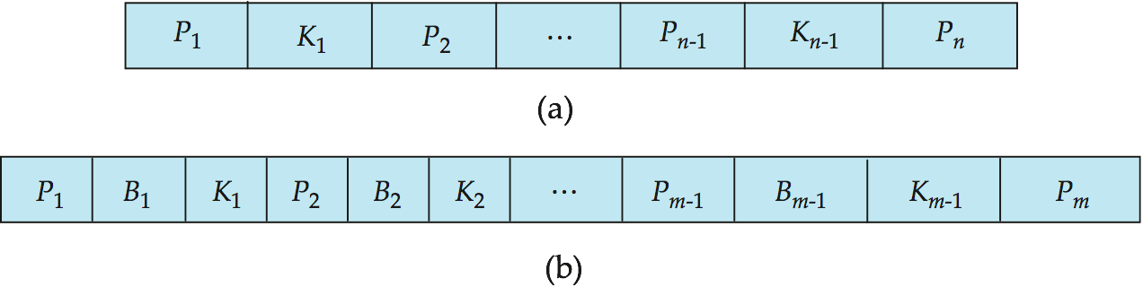
B-Tree Index Files
B-tree allows search-key values to appear only once
eliminates redundant storage of search keys.
Search keys in nonleaf nodes appear nowhere else in the B-tree; an additional pointer field for each search key in a nonleaf node must be included.
Generalized B-tree leaf node
Nonleaf node – pointers Bi are the bucket or file record pointers

Slide 49
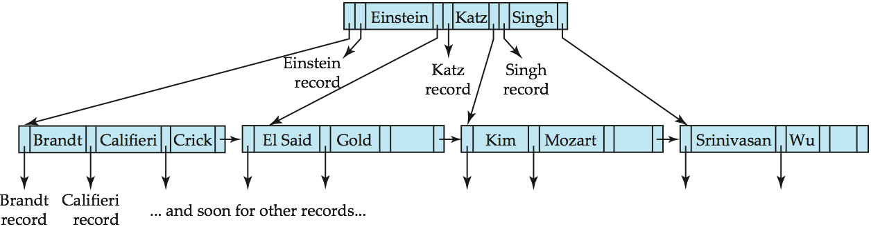
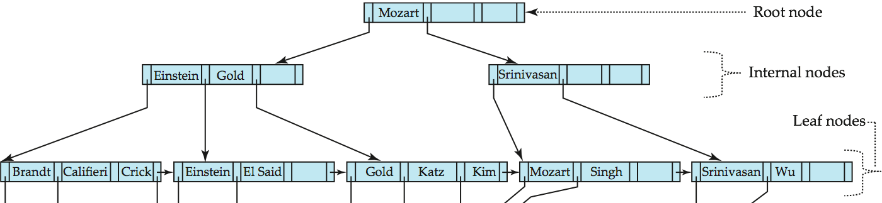
B-tree (above) and B+-tree (below) on same data

Slide 50
B-Tree Index Files (Cont.)
Advantages of B-Tree indices:
May use less tree nodes than a corresponding B⁺-Tree
Sometimes possible to find search-key value before reaching leaf node.
Disadvantages of B-Tree indices:
Only small fraction of all search-key values are found early
Non-leaf nodes are larger, so fan-out is reduced. Thus, B-Trees typically have greater depth than corresponding B⁺-Tree
Insertion and deletion more complicated than in B⁺-Trees
Implementation is harder than B⁺-Trees

Slide 51
Indexing on Flash
SSD
Random I/O cost much lower on flash
20 to 100 microseconds for read/write
Writes are not in-place, and (eventually) require a more expensive erase
Optimum page size therefore much smaller
Bulk-loading still useful since it minimizes page erases
Write-optimized tree structures (discussed later) have been adapted to minimize page writes for flash-optimized search trees

Slide 52
Indexing in Main Memory
Random access in memory
Much cheaper than on disk/flash
But still expensive compared to cache read
Data structures that make best use of cache preferable
Binary search for a key value within a large B⁺-tree node results in many cache misses
B⁺- trees with small nodes that fit in cache line are preferable to reduce cache misses
Key idea: use large node size to optimize disk access, but structure data within a node using a tree with small node size, instead of using an array

Slide 53
§14.5 Hash Indices
The file records are stored in a set of buckets
a bucket is a unit of storage containing one or more records (a bucket is typically a disk block)
we obtain the bucket of an entry from its search-key value using a hash function
Hash function h
a function from the set of all search-key values K in a file to the set of all bucket addresses, i.e. the set of the addresses of file records
Entries with different search-key values may be mapped to the same bucket; thus entire bucket has to be searched sequentially to locate an entry.
In a hash index, buckets store entries with pointers to records
In a hash file organization
buckets store records, obtaining the bucket of a record directly from its search-key value using a hash function

Slide 54
Hash Indices
Static hashing
hash function h cannot be modified, while being used
Dynamic hashing
hash function h to be modified dynamically

Slide 55
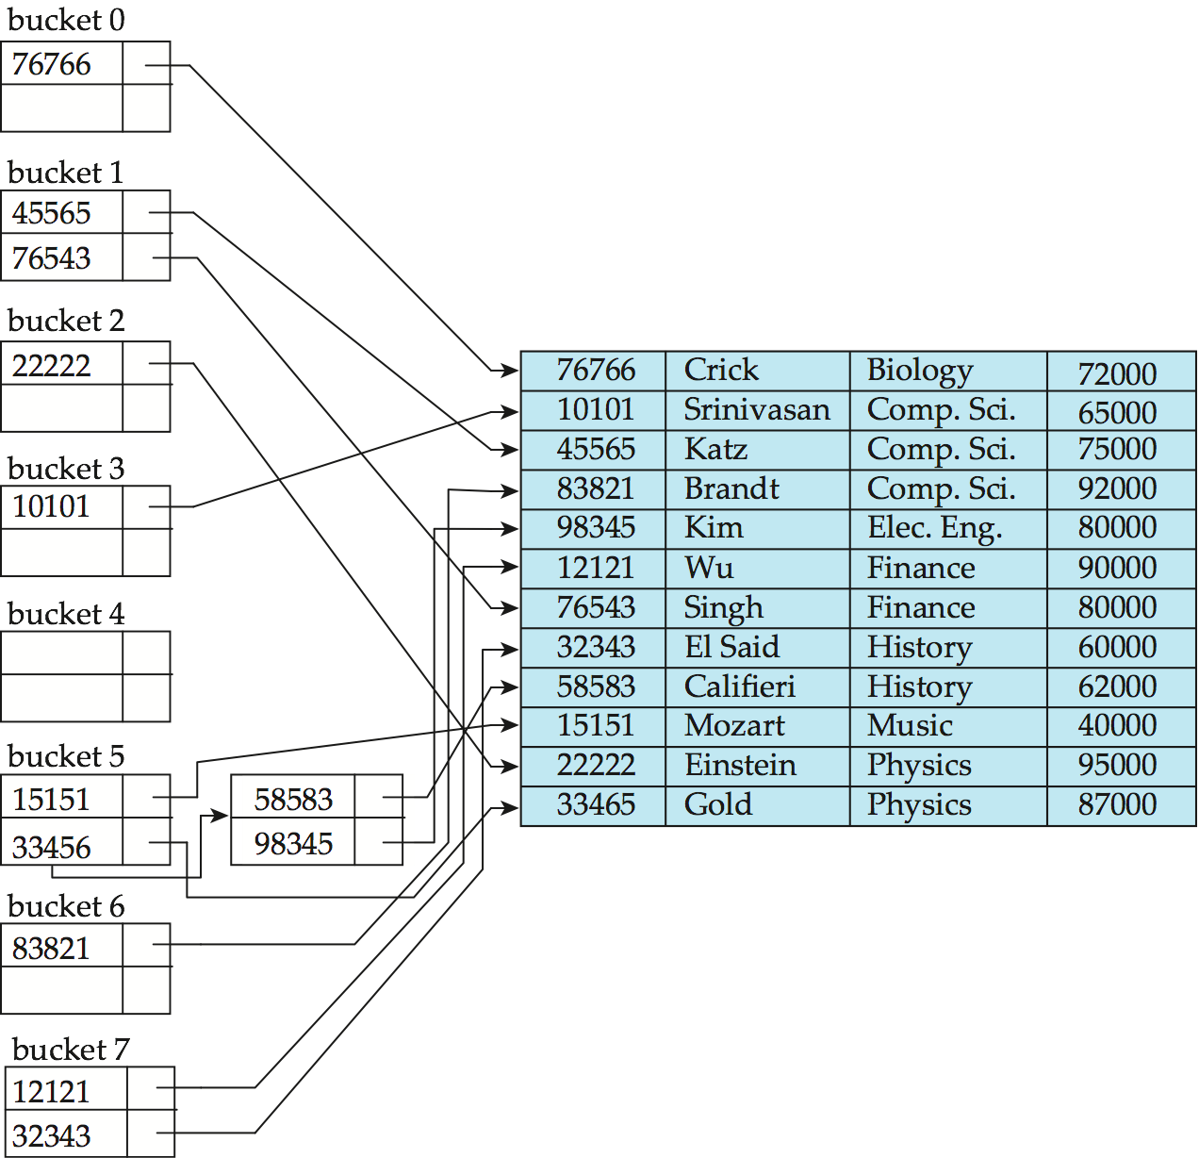
Example of Hash Index
search-key
h
hash index on instructor, on attribute ID

Slide 56
Example of Hash File Organization
Hash file organization of instructor file, using dept_name as key (See figure in next slide.)
There are 10 buckets,
The binary representation of the I ^{th} character is assumed to be the integer i.
The hash function returns the sum of the binary representations of the characters modulo 10
E.g. h(Music) = 1 h(History) = 2 h(Physics) = 3 h(Elec. Eng.) = 3

Slide 57
Example of Hash File Organization
Hash file organization of instructor file, using dept_name as key.

Slide 58
Handling of Bucket Overflows
Bucket overflow can occur because of
Insufficient buckets
Skew in distribution of records. This can occur due to two reasons:
multiple records have same search-key value
chosen hash function produces non-uniform distribution of key values
Although the probability of bucket overflow can be reduced, it cannot be eliminated; it is handled by using overflow buckets.

Slide 59
Handling of Bucket Overflows (Cont.)
Overflow chaining – the overflow buckets of a given bucket are chained together in a linked list.
Above scheme is called closed addressing (also called closed hashing or open hashing depending on the book you use)
An alternative, called open addressing (also called open hashing or closed hashing depending on the book you use) which does not use over- flow buckets, is not suitable for database applications.

Slide 60
Comparison of Ordered Indexing and Hashing
Expected type of queries:
Hashing is generally better at retrieving records having a specified value of the key, e.g. ID=10121
等值查询
If range queries are common, e.g. age between 17 and 25, ordered indices are to be preferred
Hashing index不支持range query
Cost of periodic re-organization
Relative frequency of insertions and deletions
Is it desirable to optimize average access time at the expense of worst-case access time?

Slide 61
Hash Indexing in Practical Databases
PostgreSQL supports hash indices, but discourages use due to poor performance
MySQL and PostgreSQL supports hash index
Oracle supports static hash organization, but not hash indices
SQL Server supports only B⁺-trees
CSDN（译文）：
为什么数据库使用有序索引，而程序员却在使用哈希表？

Slide 62
14.6 Multiple-Key Access
Use multiple indices for certain types of queries.
Example:
select ID
from instructor
where dept_name = “Finance” and salary = 80000
Possible strategies for processing query using indices on single attributes:
1. Use index on dept_name to find instructors with department name Finance; test salary = 80000
2. Use index on salary to find instructors with a salary of $80000; test dept_name = “Finance”.
3. Use dept_name index to find pointers to all records pertaining to the “Finance” department. Similarly use index on salary. Take intersection of both sets of pointers obtained.

Slide 63
Indices on Multiple Keys
Composite search keys are search keys containing more than one attribute
E.g., (dept_name, salary)
Lexicographic ordering: (a₁, a₂) < (b₁, b₂) if either
a₁ < b₁, or
a₁=b₁ and a₂ < b₂

Slide 64
Indices on Multiple Attributes【左前缀原则】
Suppose we have an index on combined search-key
(dept_name, salary).
With the where clause where dept_name = “Finance” and salary = 80000 the index on (dept_name, salary) can be used to fetch only records that satisfy both conditions.
Using separate indices in less efficient — we may fetch many records (or pointers) that satisfy only one of the conditions.
Can also efficiently handle where dept_name = “Finance” and salary < 80000
But cannot efficiently handle where dept_name < “Finance” and balance = 80000
May fetch many records that satisfy the first but not the second condition

Slide 65
Other Features
Covering indices（覆盖索引）
Add extra attributes to index so (some) queries can avoid fetching the actual records
Store extra attributes only at leaf
Why?
Particularly useful for secondary indices
Why?

Slide 66
14.7 Creation of Indices
Example create index takes_pk on takes (ID,course_ID, year, semester, section) drop index takes_pk
Most database systems allow specification of type of index, and clustering.
Indices on primary key created automatically by all databases
Why?
Some database also create indices on foreign key attributes
Why might such an index be useful for this query:
takes ⨝ σ_{name='Shankar'} (student)
Indices can greatly speed up lookups, but impose cost on updates
Index tuning assistants/wizards supported on several databases to help choose indices, based on query and update workload

Slide 67
Index Definition in SQL
Create an index
create index <index-name> on <relation-name> (<attribute-list>)
E.g.,: create index b-index on branch(branch_name)
Use create unique index to indirectly specify and enforce the condition that the search key is a candidate key
Not really required if SQL unique integrity constraint is supported
To drop an index
drop index <index-name>
Most database systems allow specification of type of index, and clustering.

Slide 68
强制使用/不使用索引 in SQL Server
强制使用
select*
from tbMROData with(index=timeide)
whereTimeStamp='2016-07-19T10:00:03.840'
强制不使用
alter index timeide on tbMRODatanew
disable
select*
from tbMRODatanew
where TimeStamp='2016-07-19T10:00:03.840'

Slide 69
掌握：适宜建立索引的属性
对select查询，针对select-from-where-groupby-having操作，在以下属性上建立聚集或非聚集索引，有利于提高访问速度
where子句涉及到的查询属性（e.g. budget）、连接属性(dept_name)
group-by子句中的分组属性, e.g. building
select building, avg (salary) as avg_salary
from instructor natual_join department
where budget>20000
group by building
having avg (salary) > 42000
order by dept_name desc

Slide 70
掌握：适宜建立索引的属性，索引对select/update/insert/delete的影响
对delete-from-where操作，如果在where查询条件属性上建立了索引，有利于在数据库文件中快速定位由where条件定义的需要删除的元组。但删除这些元组后，将引起DBMS将对索引进行调整重组，引起额外的系统开销，可能会降低delete的执行速度。
对insert操作，在关系表中插入新元组后，DBMS将根据新插入的元组在索引属性上的值，对表中的索引进行调整重组，必然引起额外系统开销，降低insert的执行速度

Slide 71
掌握
对update-set-where操作，如果在where查询条件属性上建立了索引，有利于在数据库文件中快速定位update需要访问的元组。但如果set操作修改了索引涉及到的属性的值，则会引发DBMS对索引的重组。索引重组带来额外的系统开销，降低了update的执行速度
E.g. 对关系表Student(ID, name, dept, age)，在属性ID上建立可聚集或非聚集索引，该索引未必能提高下述update的执行速度
update tbStudent
set ID=ID +1
where ID>20

Slide 72
例题
6. Consider the following tables mentioned above in Question 2:
factory(factoryID, name, manager, account)
employee(employeeID, name, age, factoryID)
airconditioner(serialID, date, model, price, factoryID)
(1) Consider the following SQL query. In addition to the primary indices on the primary keys of the tables, on which attributes in the tables the indices can be further defined to speed up the query?
select A.factoryID, avg(employeeID)
from factory as A, employee as B
where A.factoryID = B.factoryID and age>20 and account>30,000
group by B.factoryID
答案：以下属性上建立索引
employee表的factoryID，利于加速factory和employee两表的连接操作，也有利于group-by
employee表的age，利于从employee表中查找满足查询条件的目标元组
factory表的account，利于从factory表中查找满足查询条件的目标元组

Slide 73
例题
(2) For the following query
update airconditioner
set price = price + 100
where model =GL2020
A nonclustered index is defined on the attribute model. Does this index speed up or slow down the operation, and why?
答案
model上的索引将speed up update操作
DBMS可以根据该索引，快速找到需要update的元组，修改元组中属性price，并且该索引无需调整

Slide 74
例题
(3) For the following delete operation
delete
from airconditioner
where model=HX8302 and price>1500
A primary/clustered index has been defined on the primary key serialID. Does this index speed up or slow down the operation, and why? (4 points)
答案
将slow down delete操作
因为，根据where条件（涉及到model、price两个属性）查找需要删除的目标元组时，无法利用定义在主键serialID上的索引；并且，当删除满足where条件的目标元组后，DBMS需要花额外时间重新调整定义在serialID上的主索引
因此，整体上， serialID上的主索引降低了delete操作速度

Slide 75
例题
(4) if a multiple-attribute index (i.e. composite index) is defined on airconditioner(serialID, date, model, price, factoryID) by
create index DMFIndex on airconditioner(date, model, factoryID)
can the index DMFIndex speed up the following queries，why?
(i) select serialID
from airconditioner
where date=‘2021-11-30’ and model=‘Haier’
where条件使用了DMFIndex的两个属性，且满足左前缀，索引起作用，可加速查询
(ii) select serialID
from airconditioner
where date=‘2021-11-30’ and price>2000
where条件使用了DMFIndex的一个属性date，且满足左前缀，索引起作用，可加速查询
如果查询条件改为：
where model=‘Haier’ and price>2000
，索引不起作用

Slide 76
例题
(ii) select serialID
from airconditioner
where date=‘2021-11-30’ and factoryID=1040
where条件使用了DMFIndex的两个属性date和factoryID，但不满足左前缀，索引不起作用，无法加速查询
(IV) select serialID
from airconditioner
where model=‘Haier’ and factoryID=1040
where条件使用了DMFIndex的两个属性model和factoryID，但不满足左前缀，索引不起作用，无法加速查询

Slide 77
实验7. 数据库物理设计
on openGauss, SQL Server?
1. 了解SQL SERVER数据库的物理设计主要内容。
2. 掌握SQL SERVER数据库的文件（包括主文件、辅助文件和日志文件）和文件组（主文件组、其他文件组）的设计。
3. 掌握SQL SERVER数据库索引的设计，包括聚集索引、非聚集索引和复合索引等，分析索引对select/update/insert/delete的影响。
4.掌握利用SQL Server Management Studio分析观察SQL语句的查询执行计划，对比查询需求相同、实现方式不一样的不同SQL语句在查询结果、查询执行计划、执行时间上的区别。
5.了解掌握定长、变长属性对关系表存储空间和访问速度的影响。

Slide 78
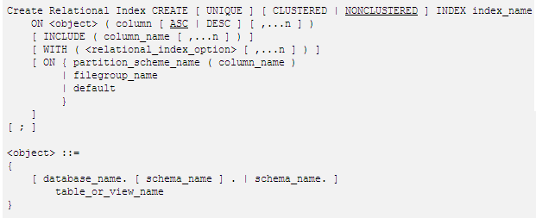
Create index in SQL Server

Slide 79
唯一索引 in SQL Server
如果存在唯一索引，数据库引擎 会在每次插入操作添加数据时检查重复值。可生成重复键值的插入操作将被回滚，同时数据库引擎 显示错误消息。即使插入操作更改多行但只导致出现一个重复值时，也是如此。
如果在存在唯一索引并且 IGNORE_DUP_KEY 子句设置为 ON 的情况下输入数据，则只有违反 UNIQUE 索引的行才会失败。有关唯一索引的详细信息，请参阅创建唯一索引

Slide 80
14.9 Bitmap Indices【略】
Bitmap indices are a special type of index designed for efficient querying on multiple keys
Records in a relation are assumed to be numbered sequentially from, say, 0
Given a number n it must be easy to retrieve record n
Particularly easy if records are of fixed size
Applicable on attributes that take on a relatively small number of distinct values
E.g., gender, country, state, …
E.g., income-level (income broken up into a small number of levels such as 0-9999, 10000-19999, 20000-50000, 50000- infinity)
A bitmap is simply an array of bits

Slide 81
Bitmap Indices
In its simplest form a bitmap index on an attribute has a bitmap for each value of the attribute
Bitmap has as many bits as records
In a bitmap for value v, the bit for a record is 1 if the record has the value v for the attribute, and is 0 otherwise
Example

Slide 82
Bitmap Indices (Cont.)
Bitmap indices are useful for queries on multiple attributes
not particularly useful for single attribute queries
Queries are answered using bitmap operations
Intersection (and)
Union (or)
Each operation takes two bitmaps of the same size and applies the operation on corresponding bits to get the result bitmap
E.g., 100110 AND 110011 = 100010
100110 OR 110011 = 110111 NOT 100110 = 011001
Males with income level L1: 10010 AND 10100 = 10000
Can then retrieve required tuples.
Counting number of matching tuples is even faster

Slide 83
Efficient Implementation of Bitmap Operations
Bitmaps are packed into words; a single word and (a basic CPU instruction) computes and of 32 or 64 bits at once
E.g., 1-million-bit maps can be and-ed with just 31,250 instruction
Counting number of 1s can be done fast by a trick:
Use each byte to index into a precomputed array of 256 elements each storing the count of 1s in the binary representation
Can use pairs of bytes to speed up further at a higher memory cost
Add up the retrieved counts
Bitmaps can be used instead of Tuple-ID lists at leaf levels of B⁺-trees, for values that have a large number of matching records
Worthwhile if > 1/64 of the records have that value, assuming a tuple-id is 64 bits
Above technique merges benefits of bitmap and B⁺-tree indices

Slide 84
Bitmap Indices (Cont.)
Bitmap indices generally very small compared with relation size
E.g., if record is 100 bytes, space for a single bitmap is 1/800 of space used by relation.
If number of distinct attribute values is 8, bitmap is only 1% of relation size

Slide 85
14.11 Spatial and Temporal Indices 【略】
Spatial searching：
查找500米范围内的餐馆的名字和地址
位置相关查询，空间数据组织与检索
Spatial database
谷歌/百度/高德地图
地理信息系统GIS：MapInfo，ArcGIS
Spatial Oracle/SQL/DB2
空间检索：计算机图形学，计算机视觉，游戏引擎
R-tree，Kd-tree

Slide 86
Example
本查询表达的含义
asks for police units (i.e., police stations, policemen, and police cars according to the class hierarchy that we consider in our prototype) that are within 0.56 miles around car38 (a stolen car), and the police cars within 0.42 miles around policeCar5 (the current chaser police car).
SELECT policeUnit.id, policeCar.id
FROM policeUnit, policeCar
WHERE inside(0.56 miles, ‘car38’, policeUnit)
AND inside(0.42 miles, ‘policeCar5’, policeCar)
AND policeCar.id<> ‘policeCar5’

Slide 88
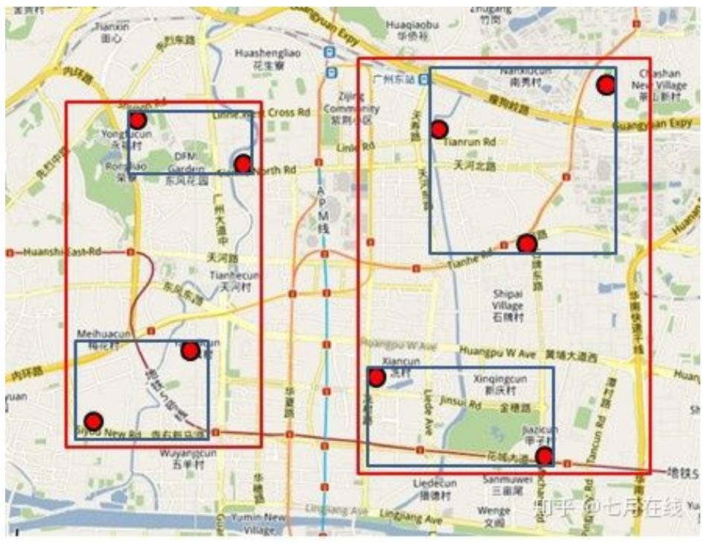
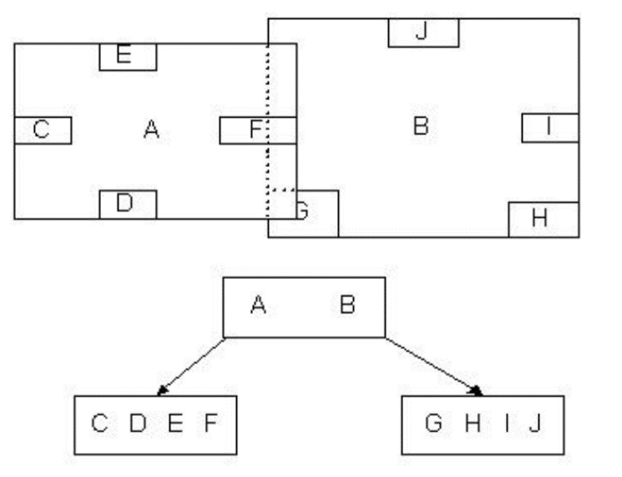
R tree
1984年，加州大学伯克利分校Guttman，“R-trees: a dynamic index structure for spatial searching” ACM, 1984, 14
借鉴B/B⁺ tree，空间分割，高维空间数据存储与索引
R树示例

Slide 89

Thanks for your attention

